Slide 1
SAP SD (SALES AND DISTRIBUTION) Presentation on MRP (Material Requirement PLANNING) AND AVAILAIBILITY TO PROMISE (ATP)

Slide 2
Name:- Romit Pal
Company:- Sisoft Technologies
Designation:-SAP INTERN at Sisoft Inc.
Topic:- MRP (Material Requirement Planning ) and availaibility to Promise

Slide 3
MATERIAL REQUIREMENT PLANNING
1) The SAP MRP(Material Requirement Planning) is used to procure or produce the required material quantities on time for in-house purpose or for fulfilling customer demands.
2) In manufacturing, the function of MRP is to guarantee material availability on time.
3) The main objective is to plan the supply based on requirements and considering the current stock in hand and meet the shortages.

Slide 4
Availaibility to PROMISE
1) SAP ATP (Available to promise) is a critical calculation used in supply chain management, manufacturing, and fulfillment.
2) It’s also highly relevant for SAP e-commerce.
3) SAP ATP requires you to model your entire supply chain and manufacturing process.

Slide 5
STEPS IN MATERIAL REQUIREMENT PLANNING (MRP) AND AVAILIABILITY TO PROMISE IN SAP SD
1)Define Condition Tables
2)Define Access sequence
3)Define Condition Types
4)Define Material determination
5)MRP1,MRP2,MRP3,MRP4

Slide 6
1) Define condition tables
1)Condition Tables are combination of condition masters like sales organization,customer material,distribution channel etc.
2)Condition Table consists of one or more condition keys and data apart.
3) SAP Route:-SPRO → IMG → Sales and Distribution → Basic Functions → Pricing → Pricing Control → Define Conditional Tables
4) T-Code:- V/03

Slide 7
1)The T-Code v/03 in the sap T-code bar. Press Enter a new screen appears which shows the option of entering the condition table no and then press enter a new screen appears as mentioned below.

Slide 8
2) Enter the data as mentioned in the table and select the parameters for condition tables as mentioned in the table and click on save a condition table 715 is created.

Slide 9
2) DEFINE ACCESS SEQUENCES
1)The access sequence is a search strategy which the SAP System uses to search for condition records valid for a condition type.
2)SAP ROUTE :-SPRO -> Implementation Guide (IMG) => Sales and Distribution (SD) => Basic functions => Pricing => Pricing control => Maintain access sequences.
3) T-Code:- V/07

Slide 10
1) The T-Code for this transaction is v/07 in the sap T-code bar. Press Enter a new screen appears which shows the record of access sequences present in the system.

Slide 11
2) Just click on new entries the values as mentioned below in the table and select the option and click on access and put your condition records and click on save new access sequence has been created.

Slide 12
3) Select the access and click on field and it will show whether the field is active or inactive.

Slide 13
3)DEFINE CONDITION TYPES
1)Price elements are represented in the SAP system by condition types. Price elements can be, for example, prices, surcharges, discounts, taxes or, freight, and are stored in the system in condition records.
2) Condition type is used for different types of charges.
3) It controls pricing components and pricing items.
4) SAP ROUTE:-SPRO -> Implementation Guide (IMG) => Sales and Distribution (SD) => Basic functions => Pricing => Pricing control =>Define condition types => Maintain condition types.
5) T-Code:-V/06

Slide 14
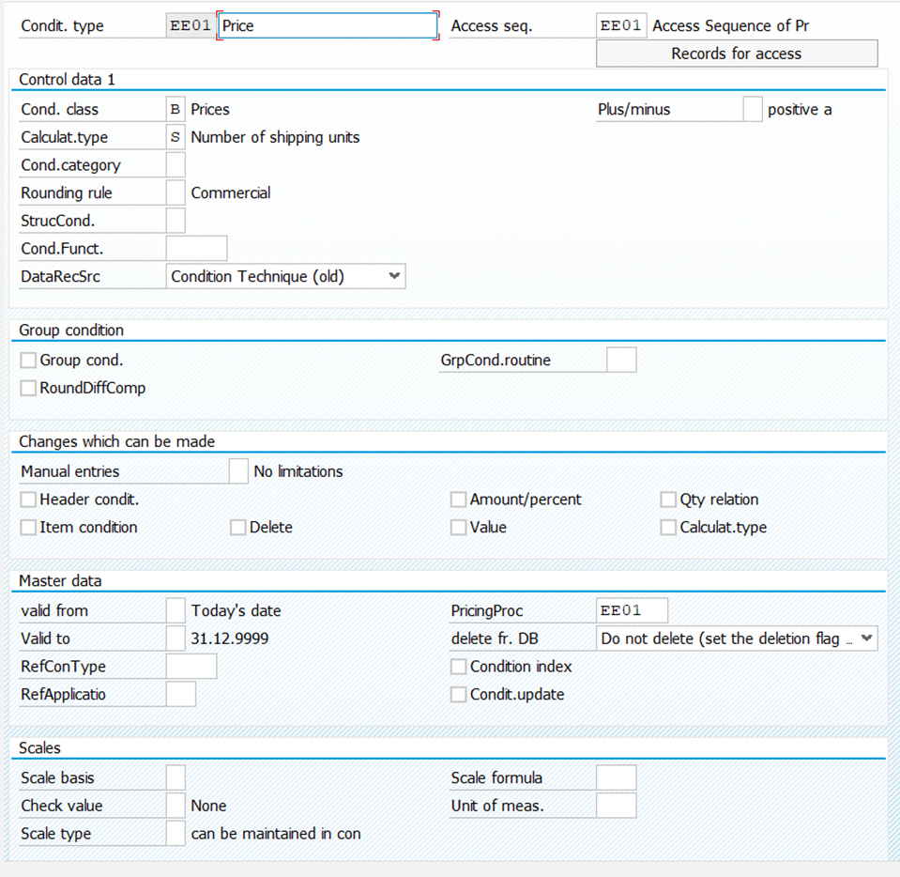
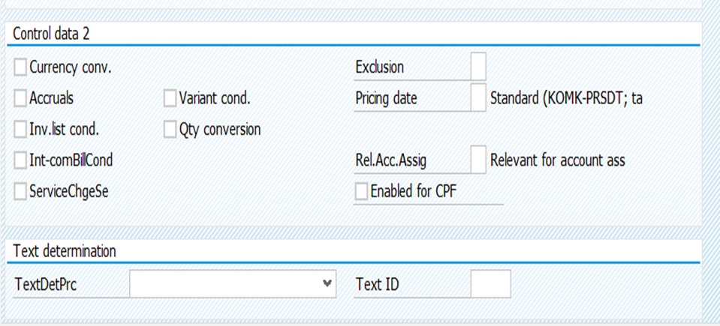
1) The T-Code is v/06 in the sap T-code bar. Press Enter a new screen appears which shows the existing data of condition type records with data as follows which mentions condition types, Condition type description, condition class and calculation type. Then above the option comes with new entries and copy as.Then click on new entries a new screen appears as mentioned below and the data is to be put as mentioned below in the table with all options.

Slide 15
4) Define MATERIAL DETERMINATION
1) Material determination substitutes/exchanges one material with another material in sales order within a specific date range/interval. It uses the condition technique to replace one material with another material maintained in the condition records when the condition meets.
2) SAP Route:-SPRO – Sales and Distribution- Basic Functions- Material Determination
2) The customizing requires 4 major steps:
Step 1:- Prepare Condition technique steps- Like condition tables, access sequence, condition type, Material determination procedure.
Step 2:-Assigning Material determination procedure to sales order type(s)
Step 3:-Creating Substitution Reasons
Step 4:-Creating condition records for the condition types

Slide 16
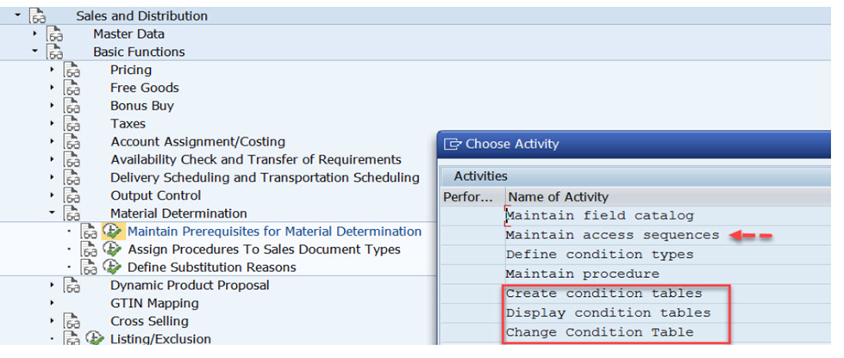
Step 1:- Prepare Condition technique steps- Like condition tables, access sequence, condition type, Material determination procedure.
1) In material determination click on maintain perquisites for material determination and select define access sequences.
2) SAP Route:-SPRO – Sales and Distribution- Basic Functions- Material Determination-Maintain Perquisites for Material Determination-Maintain Access Sequence.

Slide 17
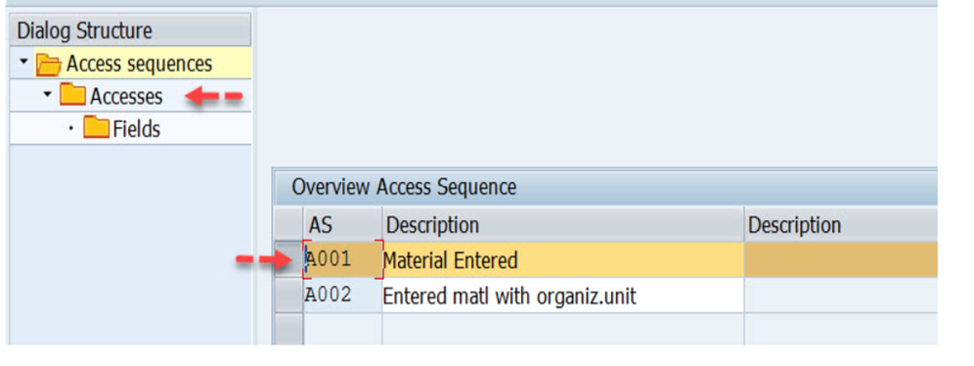
2) Select one by one and from lest hand side choose Accesses to see the access lines with condition tables.

Slide 18
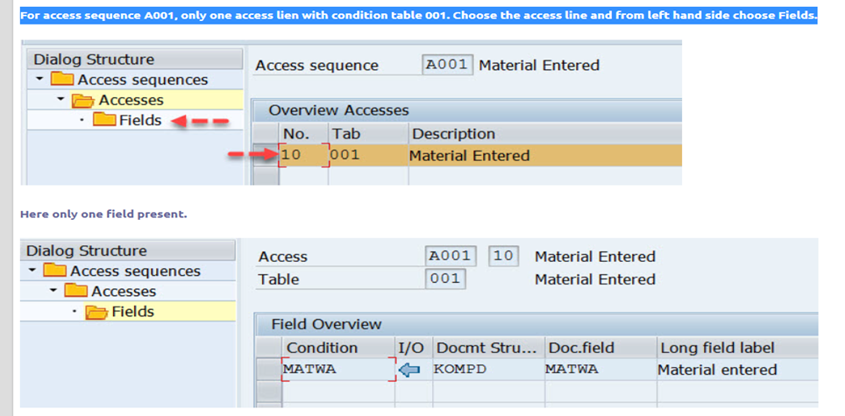
3) For access sequence A001, only one access lien with condition table 001. Choose the access line and from left hand side choose Fields.

Slide 19
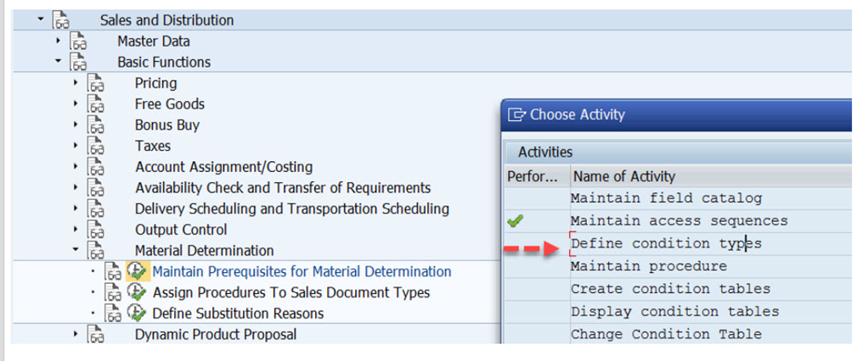
4) Now choose the option define condition types. condition type A001 is created and assigned to the access sequence A001. (T-Code-OV12)
SAP Route:-SPRO – Sales and Distribution- Basic Functions- Material Determination-Maintain Perquisites for Material Determination-Define Condition Types.

Slide 20
5) Now choose the option define condition types

Slide 21
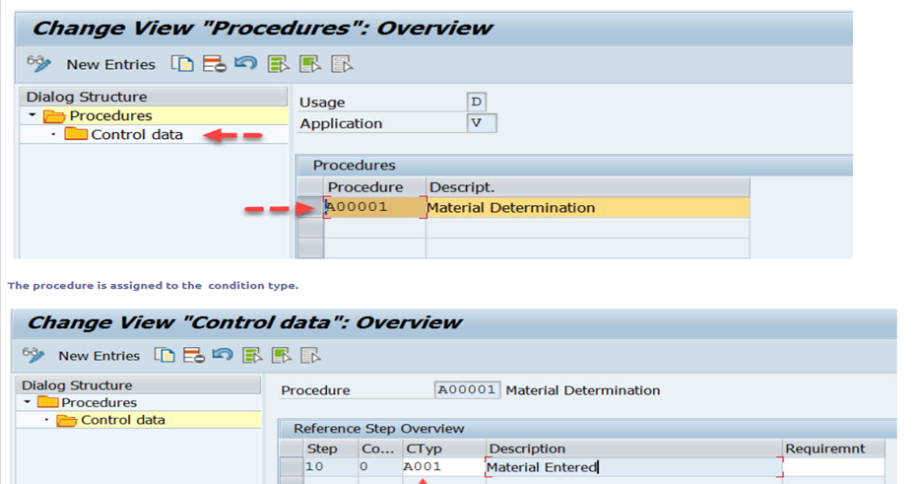
7) Maintain Procedure to create Material Determination Procedure and select the available procedure and select control data from left side.

Slide 22
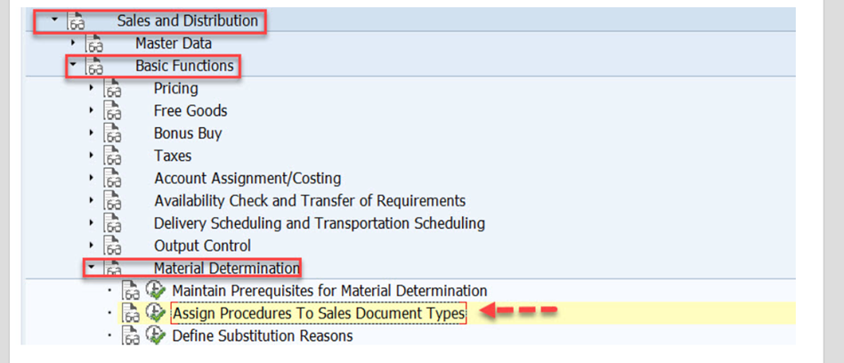
Step 2:-Assigning Material determination procedure to sales order type(s)
8) Assign Procedures to Sales Document Types.
B) SAP Route:-SPRO – Sales and Distribution- Basic Functions- Material Determination-Assign Procedures to Sales document types.(T-Code-OV14)

Slide 23
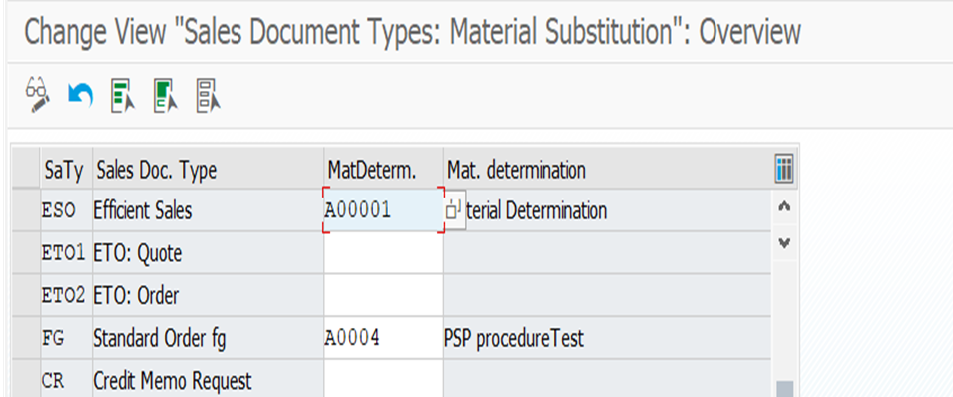
9) Here the material determination procedure is assigned to the Efficient Sales Order ESO.

Slide 24
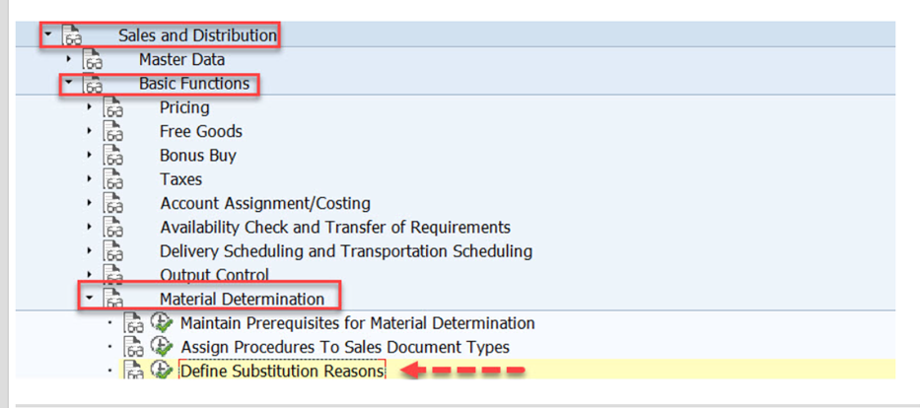
10) Nest step is to define the Substitution reason, Choose the option- Define Substitution Reasons.
B) SAP Route:-SPRO – Sales and Distribution- Basic Functions- Material Determination-Define substitution reasons.(T-Code- OVRQ)

Slide 25
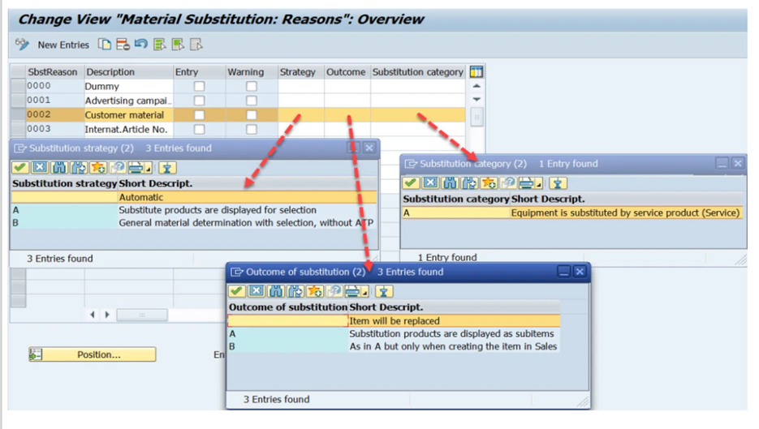
Step 3:-Creating Substitution Reasons
11) Here you can create substitution reason and you can make your decision for the three fields: Strategy, Outcome & Substitution Category from the available F4 options.

Slide 26
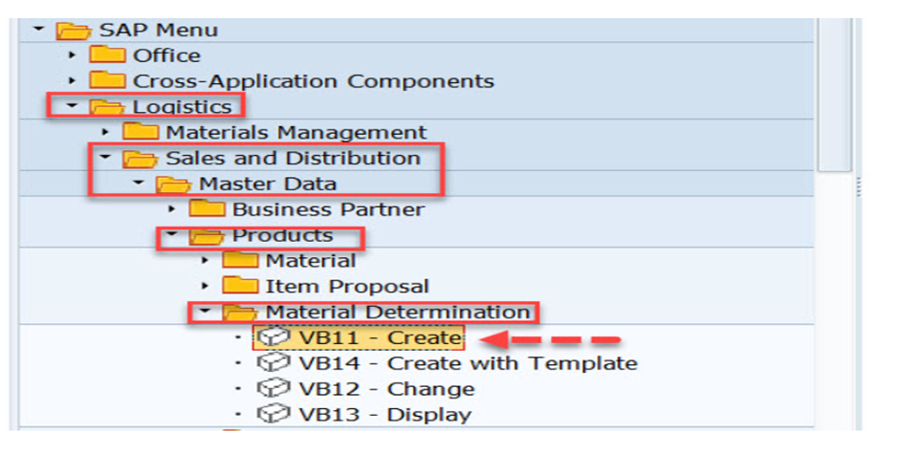
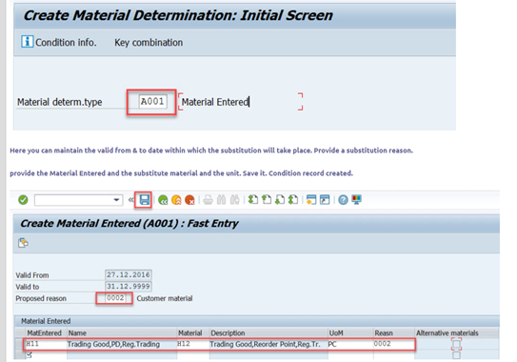
Step 4:-Creating condition records for the condition types
1) Choose Tx- VB11 to create condition records.
2)SAP Route:- SAP Menu-Logistics-Sales and Distribution-Master Data-Products-Material Determination-VB11-Create

Slide 27
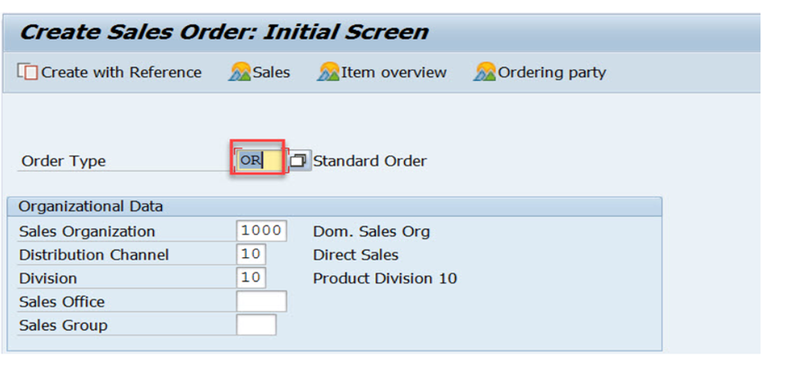
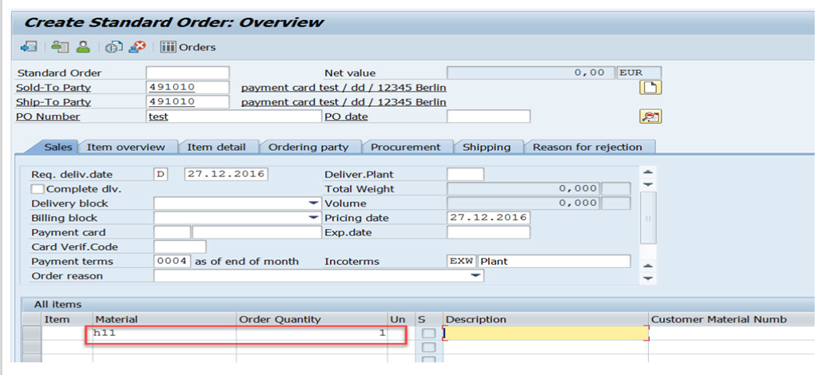
Now lets check if the material substitution is happening or not by creating a sales order in Tx- VA01 by creating a sales order of type ESO as the material determination procedure is assigned to the sales order type ESO.

Slide 28
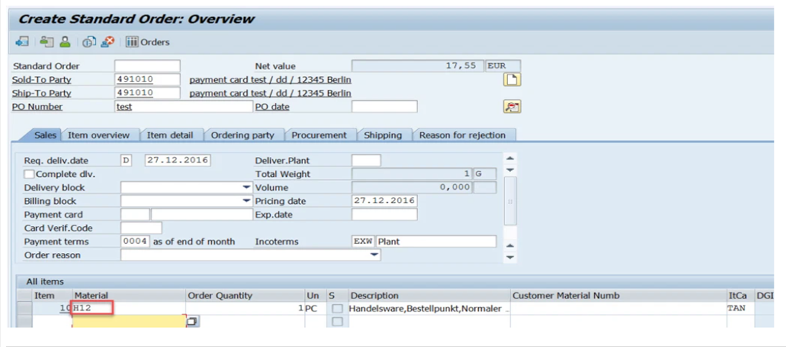
From the condition record it finds substitute material and replaces it in the sales order.

Slide 29
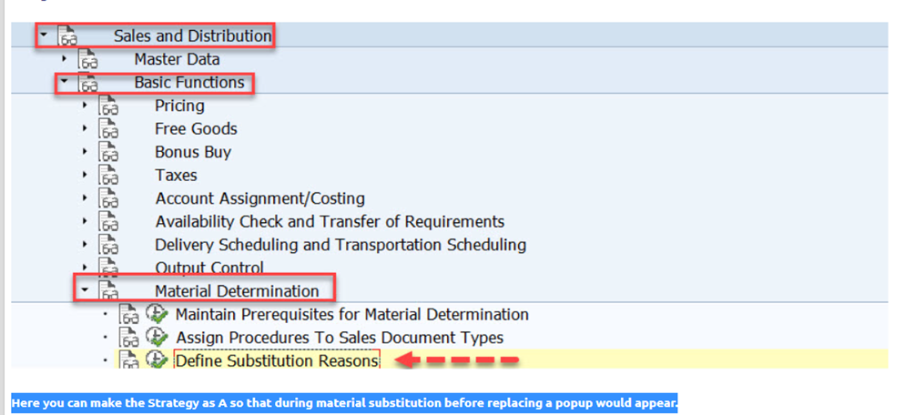
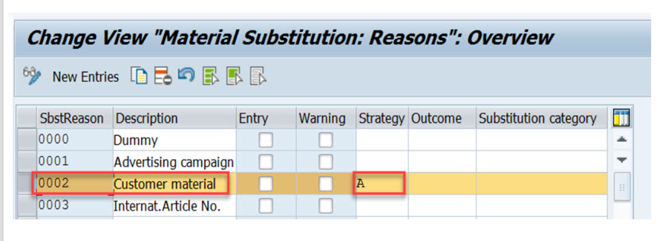
Now go to the Define Substitution reason. Here you can make the Strategy as A so that during material substitution before replacing a popup would appear.

Slide 30
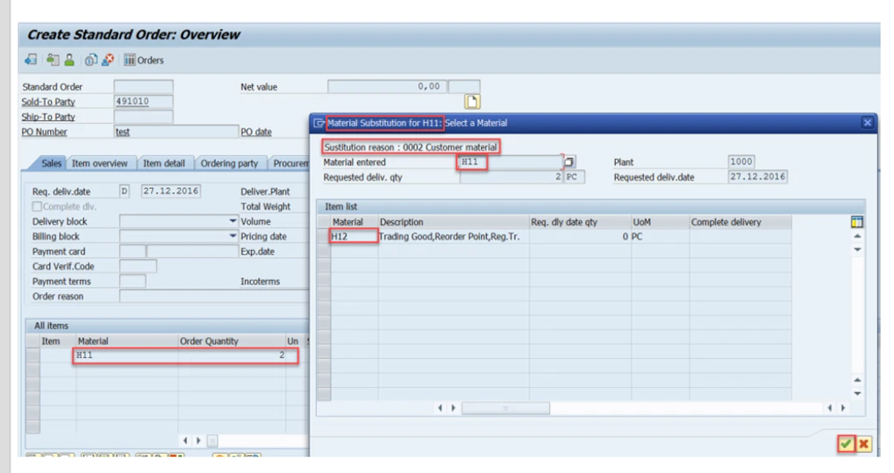
Create a sales order and provide the material and quantity and hit enter key. A pop appears displaying the substitution of materials popup. You can select the material and press continue button.

Slide 31
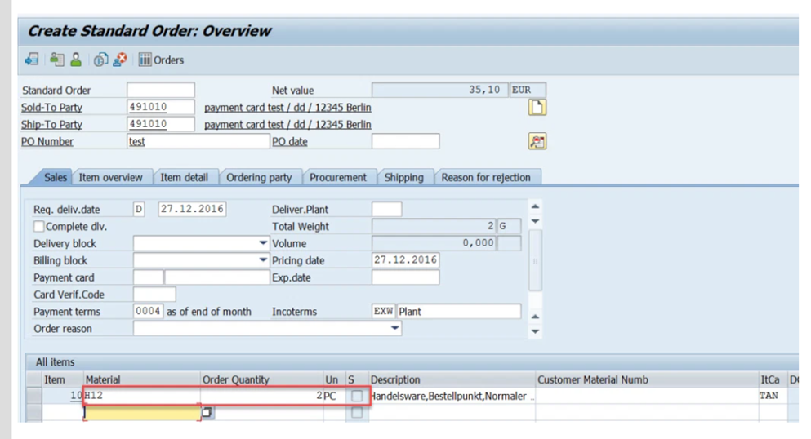
The material is replaced in the sales order.

Slide 32
5) 5.1 MRP 1
1) MRP 1 Contains following options like basic unit of measure ,MRP Type,MRP Group and Lot size etc as mentioned in the image below.
2) MRP Type:-SAP MRP type is a field that is maintained in the material master MRP 1 view under MRP procedure data. This is a key which is used to regulate the material requirements planning.
3) MRP Group :- The MRP group is an organizational object that can be used to allocate special control parameters for planning to a group of materials. You can maintain MRP groups if planning control per plant is not precise enough for your requirements and you want to allocate certain material groups different control parameters from the plant parameters.

Slide 34
5.2 MRP 2
1) MRP 2 contains following sections like procurement type,batch entry,storage location for EP,In house production etc as mentioned in the image .
2) Procurement Type:-Procurement Type is used to determine whether a material is procured in-house or it can be procured externally, i.e. a planned order or a purchase order needs to be created. The type of procurement completely depends on the material type.
3) Storage Location:-A storage location, in SAP but also in physical inventory, is the place where stock is stored in a plant, a specific location. It is used to differentiate different type of stocks within a plant.

Slide 36
5.3 MRP 3
1) MRP 3 Contains elements like Period indicator,availaibility check and fiscal year variant etc. as mentioned in the image below.
2) Availability check:-During sales order processing, the availability check enables you to tell the customer if the product can be delivered on time. You can control how the availability check is carried out by setting the Availability check field in the material master.
3) Period Indicator:-The period indicator defines the periodicity used to record the historical values for the forecast and the periodicity to be used to output the forecast values. It can be Monthly or Weekly or Daily or based on FY variant.
4) Fiscal Year Variant:-Fiscal year variant contains the number of posting periods in a fiscal year and the number of special periods. You can define up to 16 posting periods in a fiscal year in the controlling component CO. You need to specify the fiscal year variant for each company code.

Slide 38
5.4 MRP 4
1) MRP 4 Contains selection method, component scrap percentage, Requirement group etc as mentioned in the image below.
2) Selection Method :- Selection method is 2 or 3 (Selection by production version): The production version can be maintained in the material master and it defines both the BOM (Bill of Material) usage.
3)Requirement Group:-A materials requirement planning (MRP) group is an object that you can use to assign common control parameters to a group of materials to plan and organize.

Slide 40
THANK YOU

